Slide 1
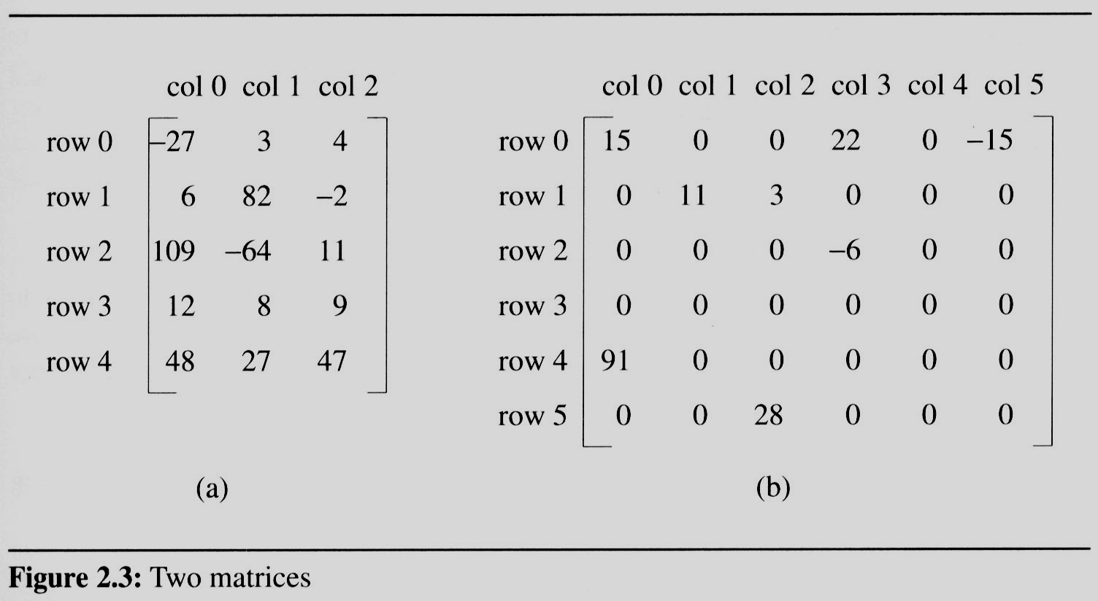
2.4 The sparse matrix ADT (1/18)
2.4.1 Introduction
In mathematics, a matrix contains m rows and n columns of elements, we write m×n to designate a matrix with m rows and n columns.
sparse matrix
data structure?
5*3
15/15
6*6
8/36

Slide 2
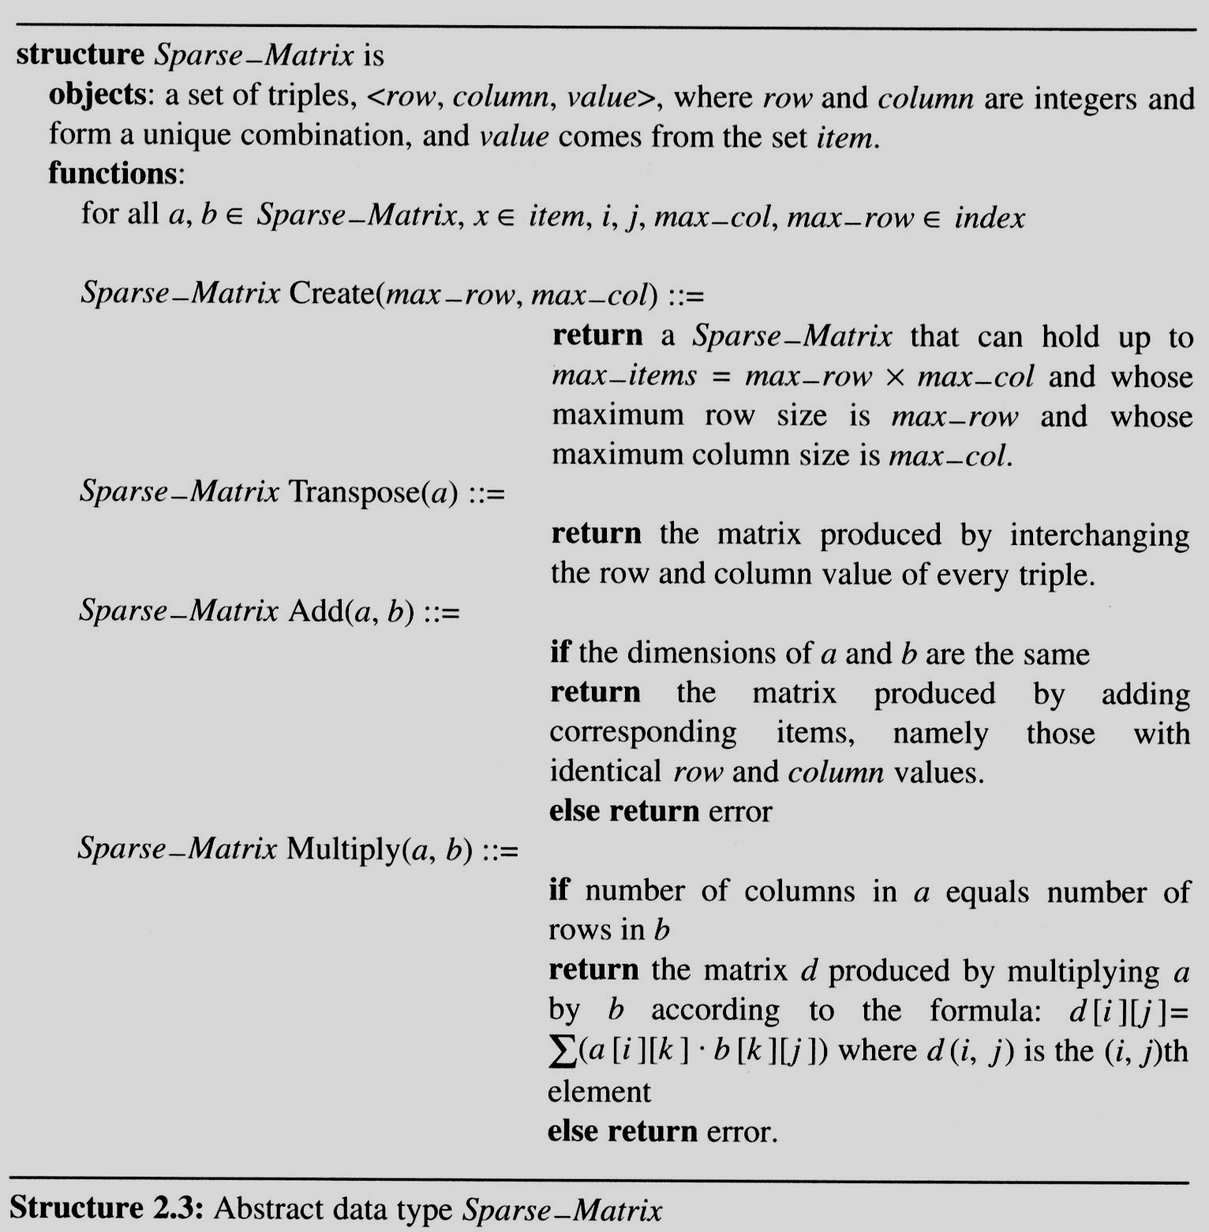
2.4 The sparse matrix ADT (2/18)
Structure 2.3 contains our specification of the matrix ADT.
A minimal set of operations
Matrix creation
Addition
Multiplication
Transpose

Slide 3
2.4 The sparse matrix ADT (3/18)
The standard representation of a matrix is a two dimensional array defined as
a[MAX_ROWS][MAX_COLS]
We can locate quickly any element by writing a[i ][ j ]
Sparse matrix wastes space
We must consider alternate forms of representation.
Our representation of sparse matrices should store only nonzero elements.
Each element is characterized by <row, col, value>.

Slide 4
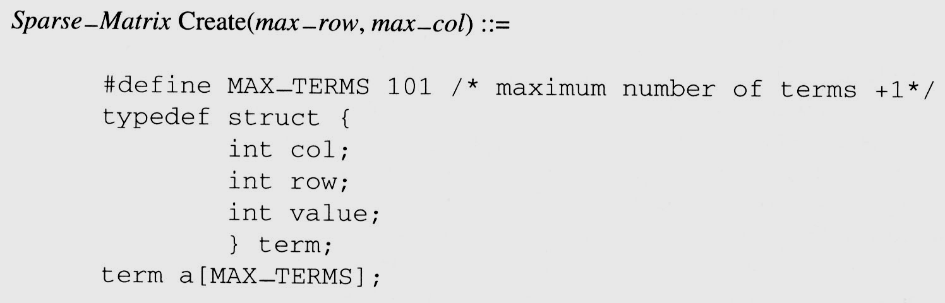
2.4 The sparse matrix ADT (4/18)
We implement the Create operation as below:

Slide 5
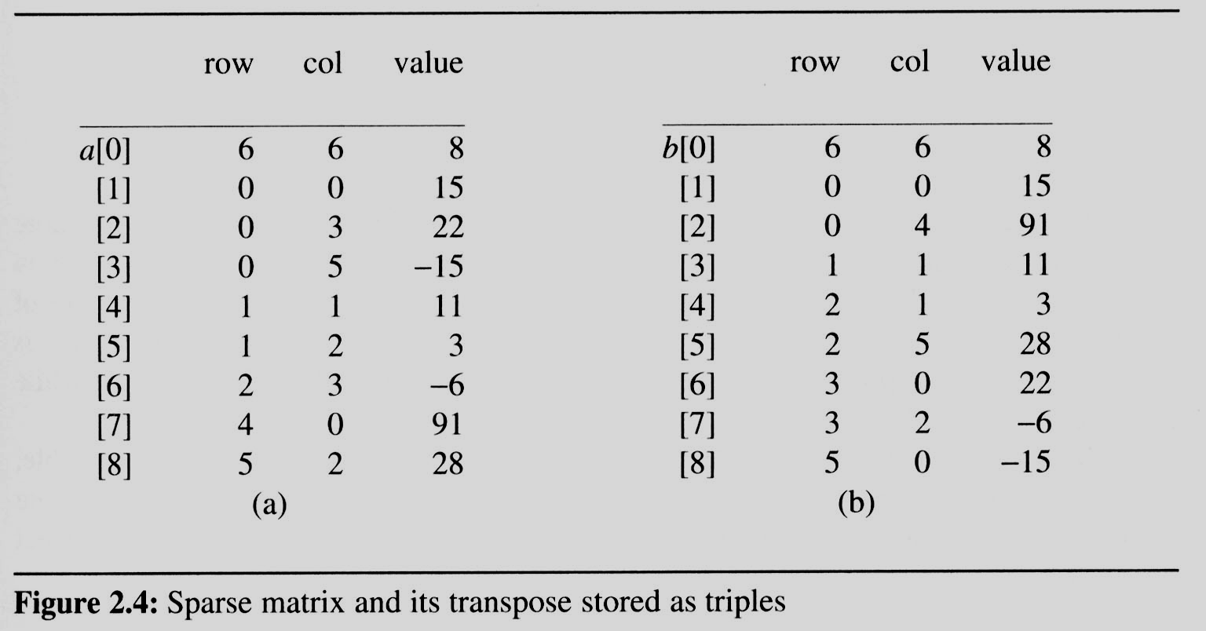
2.4 The sparse matrix ADT (5/18)
Figure 2.4(a) shows how the sparse matrix of Figure 2.3(b) is represented in the array a.
Represented by a two-dimensional array.
Each element is characterized by <row, col, value>.
# of rows (columns)
# of nonzero terms
transpose
row, column in ascending order

Slide 6
2.4 The sparse matrix ADT (6/18)
2.4.2 Transpose a Matrix
For each row i
take element <i, j, value> and store it in element <j, i, value> of the transpose.
difficulty: where to put <j, i, value> (0, 0, 15) ====> (0, 0, 15) (0, 3, 22) ====> (3, 0, 22) (0, 5, -15) ====> (5, 0, -15) (1, 1, 11) ====> (1, 1, 11) Move elements down very often.
For all elements in column j,
place element <i, j, value> in element <j, i, value>

Slide 7
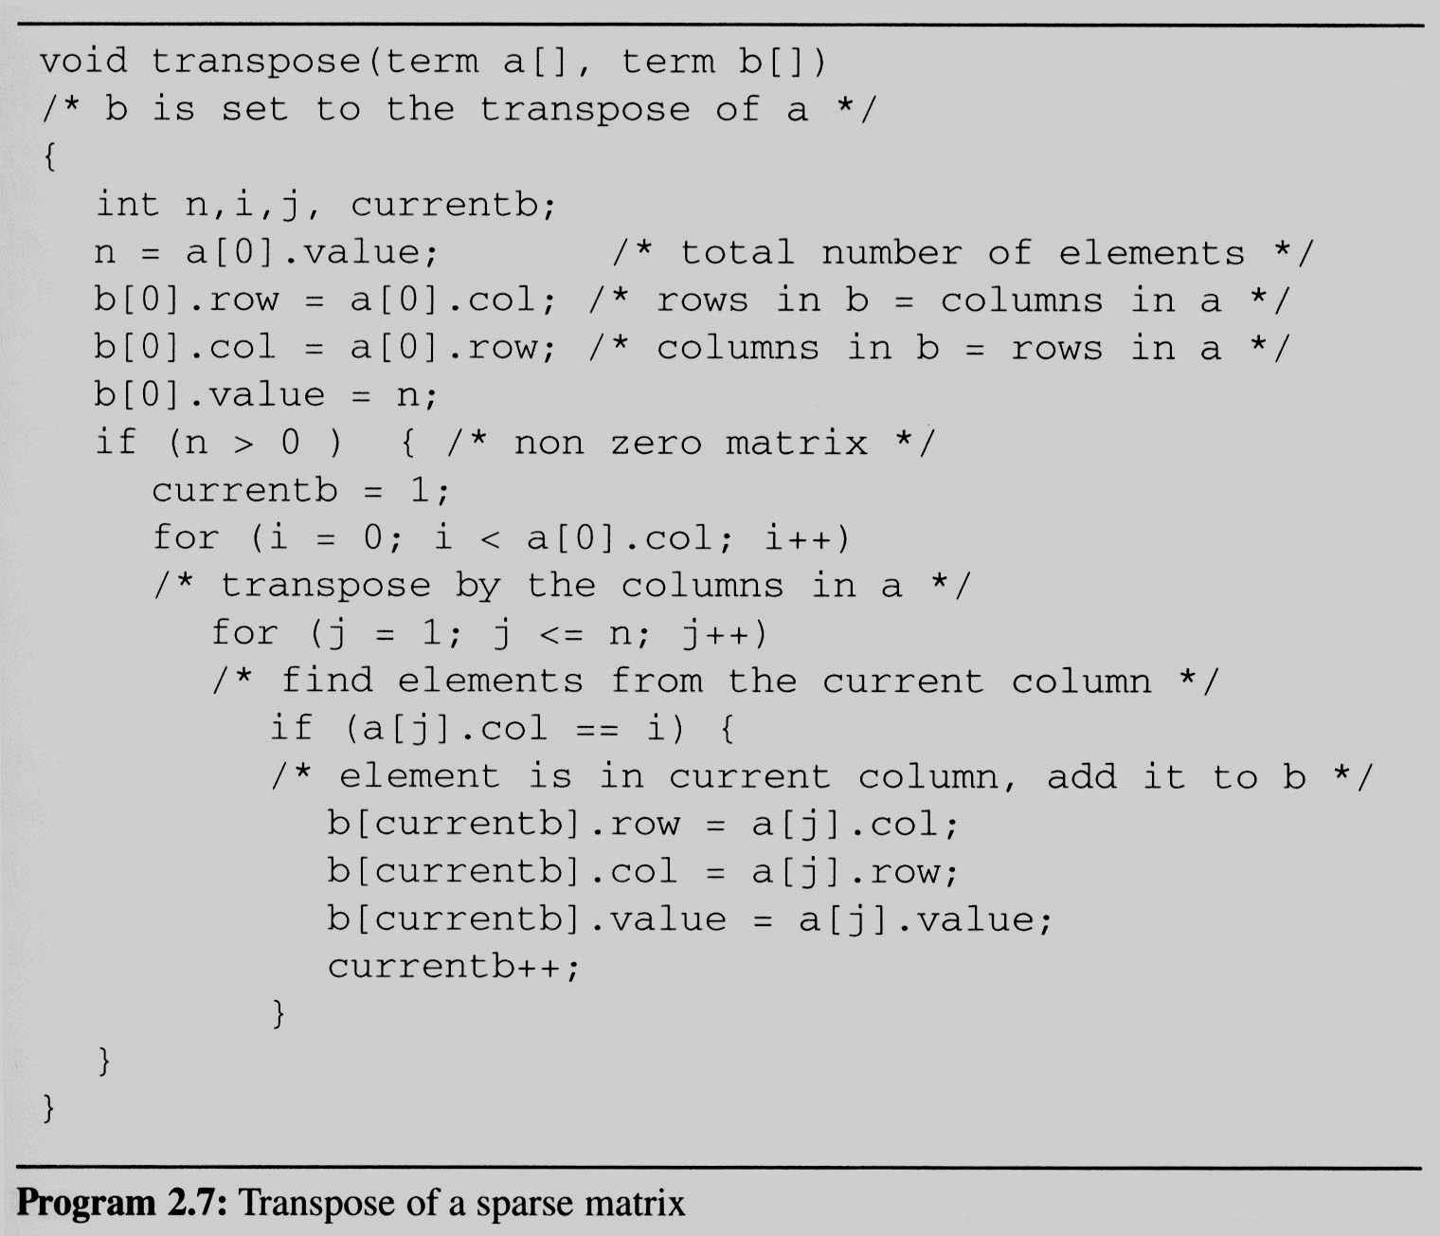
2.4 The sparse matrix ADT (7/18)
This algorithm is incorporated in transpose (Program 2.7).
Assign
A[i][j] to B[j][i]
place element <i, j, value> in element <j, i, value>
For all columns i
For all elements in column j
Scan the array “columns” times.
The array has “elements” elements.
==> O(columns*elements)

Slide 8
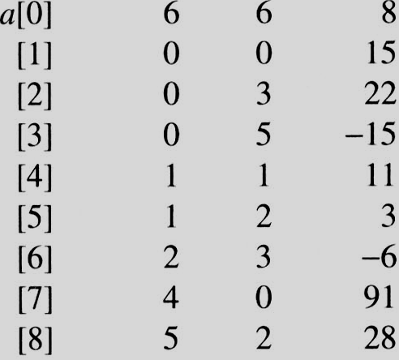
i=0 j=1
i=0 j=1
a[j]= 0 == i
i=0 j=2
i=0 j=2
a[j]=3 != i
i=0 j=3
i=0 j=3
a[j] = 5 != i
i=0 j=4
i=0 j=4
a[j].col = 1 a[j].col != i
i=0 j=5
i=0 j=5
a[j].col = 2 a[j].col != i
i=0 j=6
i=0 j=6
a[j].col = 3 != i
i=0 j=7
i=0 j=7
a[j].col = 0 == i
i=0 j=8
i=0 j=8
a[j].col = 2 != i
i=1 j=1
i=1 j=1
a[j].col = 0 != i
i=1 j=2
i=1 j=2
a[j].col = 3 != i
i=1 j=3
i=1 j=3
a[j].col = 5 != i
i=1 j=4
i=1 j=4
a[j].col = 1 == i
i=1 j=5
i=1 j=5
a[i].col = 2 != i
i=1 j=6
i=1 j=6
a[j].col = 3 != i
i=1 j=7
i=1 j=7
a[j] = 0 != i
i=1 j=8
EX: A[6][6] transpose to B[6][6]
i=1 j=8
a[i].col = 2 != i
Matrix A
Row Col Value
Set Up row & column in B[6][6]
Row Col Value
0 6 6 8
1 0 0 15
2 0 4 91
3 1 1 11
And So on…

Slide 9
2.4 The sparse matrix ADT (8/18)
Discussion: compared with 2-D array representation
O(columns*elements) vs. O(columns*rows)
elements --> columns * rows when non-sparse, O(columns²*rows)
Problem: Scan the array “columns” times.
In fact, we can transpose a matrix represented as a sequence of triples in O(columns + elements) time.
Solution:
First, determine the number of elements in each column of the original matrix.
Second, determine the starting positions of each row in the transpose matrix.

Slide 10
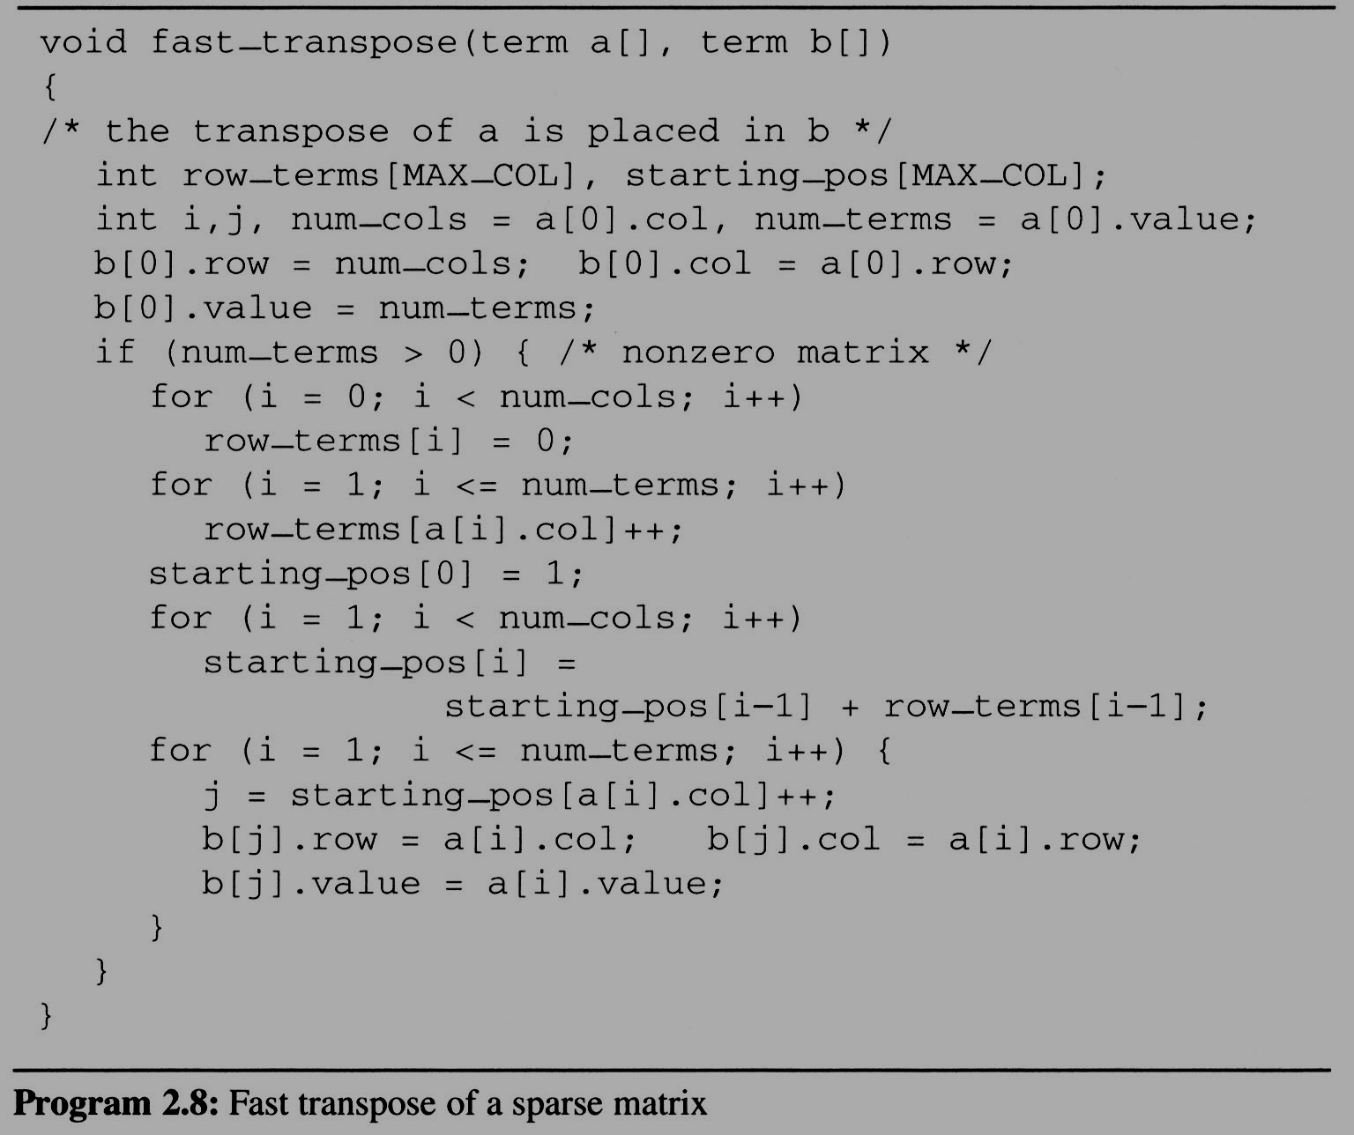
2.4 The sparse matrix ADT (9/18)
Compared with 2-D array representation: O(columns+elements) vs. O(columns*rows) elements --> columns * rows O(columns*rows)
Cost: Additional row_terms and starting_pos arrays are required.
Let the two arrays row_terms and starting_pos be shared.
For columns
Buildup row_term
& starting_pos
For elements
For columns
columns
transpose
For elements

Slide 11
2.4 The sparse matrix ADT (10/18)
After the execution of the third for loop, the values of row_terms and starting_pos are:
[0] [1] [2] [3] [4] [5] row_terms = 2 1 2 2 0 1 starting_pos = 1 3 4 6 8 8
transpose

Slide 12
[0] [1] [2] [3] [4] [5]
1
row_terms
0
2
#col = 6
#term = 6
1
2
0
1
0
1
2
0
0
0
1
Matrix A
Row Col Value
starting_pos
1
3
4
6
8
8

Slide 13
[0] [1] [2] [3] [4] [5] row_terms = 2 1 2 2 0 1 starting_pos = 1 3 4 6 8 8
[0] [1] [2] [3] [4] [5] row_terms = 2 1 2 2 0 1 starting_pos = 2 3 4 6 8 8
[0] [1] [2] [3] [4] [5] row_terms = 2 1 2 2 0 1 starting_pos = 2 3 4 7 8 8
[0] [1] [2] [3] [4] [5] row_terms = 2 1 2 2 0 1 starting_pos = 2 3 4 7 8 9
[0] [1] [2] [3] [4] [5] row_terms = 2 1 2 2 0 1 starting_pos = 2 4 4 7 8 9
[0] [1] [2] [3] [4] [5] row_terms = 2 1 2 2 0 1 starting_pos = 2 4 5 7 8 9
[0] [1] [2] [3] [4] [5] row_terms = 2 1 2 2 0 1 starting_pos = 2 4 5 8 8 9
[0] [1] [2] [3] [4] [5] row_terms = 2 1 2 2 0 1 starting_pos = 3 4 5 8 8 9
[0] [1] [2] [3] [4] [5] row_terms = 2 1 2 2 0 1 starting_pos = 3 4 6 8 8 9
I = 1
I = 2
I = 3
I = 4
I = 5
I = 6
I = 7
I = 8
Matrix A
Row Col Value
Row Col Value
0 6 6 8
1 0 0 15
2 0 4 91
3 1 1 11
4 2 1 3
5 2 5 28
6 3 0 22
7 3 2 -6
8 5 0 -15

